Slide 1
TDP, Stream it and Lambda it
May 5, 2017

Slide 2
Agenda
λ Expression
Stream API in a nut shell
Optional
New Date API

Slide 3

λ Expression
Anonymous function
Method without a declaration
Instance of a functional interface
Function is a first class citizen
Notes:
lambdas as an instance of an interface type

Slide 4
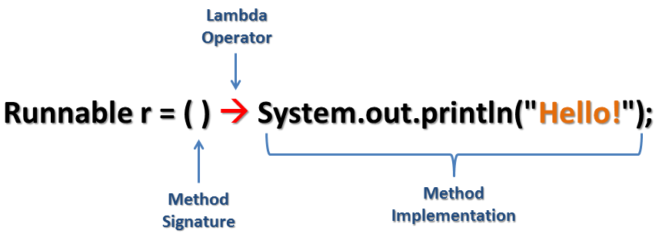
λ Expression
Notes:
lambdas as an instance of an interface type

Slide 5
λ Expression
(type1 arg1, type2 arg2...) -> { body }
(arg1, arg2...) -> { body }
Notes:
lambdas as an instance of an interface type

Slide 6
λ Expression
(int a, int b) -> { return a + b; }
(a, b) -> { return a + b; }
(a, b) -> a + b
a -> return a*a
() -> System.out.println("Hello World");
(String s) -> { System.out.println(s); }
() -> { return 3.1415;}
() -> 42

Slide 7
λ Expression
List<String> names = Arrays.asList("peter", "anna", "mike", "luna", "jacob", "angela");
// java 7 code for (String name : names) System.out.println(name);
// java 8 code with lambda names.forEach((String name) -> System.out.println(name));

Slide 8
λ Expression
Lambda under the hood
// java 8 code with forEach names.forEach(new Consumer<String>() { @Override public void accept(String name) { System.out.println(name); } });

Slide 9
λ Expression @FunctionalInterface
Functional Interface @FunctionalInterface
Single Abstract Method (SMA) interface
Could have default method with implementation

Slide 10
λ Expression @FunctionalInterface
Examples in Java API?
Runnable
Callable
Comparator
Consumer
Predicate

Slide 11
λ Expression In Runnable
Runnable runnable1 = new Runnable() { @Override public void run() { System.out.println("Hello Lambda"); } }; new Thread(runnable1).start(); Runnable runnable2 = () -> System.out.println("Hello Lambda"); new Thread(runnable2).start();

Slide 12
λ Expression In Comparator
Collections.sort(names, new Comparator<String>() { @Override public int compare(String a, String b) { return b.compareTo(a); } }); Collections.sort(names, (String a, String b) -> { return b.compareTo(a); }); Collections.sort(names, (String a, String b) -> b.compareTo(a)); Collections.sort(names, (a, b) -> b.compareTo(a)); Collections.sort(names, Comparator.reverseOrder());

Slide 13
λ Expression In Consumer
// java 8 code with lambda names.forEach((String name) -> System.out.println(name)); // java 8 code with lambda names.forEach(name -> System.out.println(name)); // java 8 code with method reference names.forEach(System.out::println);

Slide 14

Stream

Slide 15
Stream
SQL-Like Operation
Declarative
Lazy evaluation
Promote immutability
Easier parallelization
Clean and concise code

Slide 16
Stream
Given a collection of Transactions
List<Transaction> transactions
Find out all transactions of type grocery
return a list of transaction IDs
sorted in decreasing order of transaction value

Slide 17
Stream
// filter out the GROCERY type List<Transaction> groceryTransactions = new ArrayList<>(); for(Transaction t: transactions){ if(t.getType() == TransactionType.GROCERY){ groceryTransactions.add(t); } } // sort by value Collections.sort(groceryTransactions, new Comparator<Transaction>() { @Override public int compare(Transaction t1, Transaction t2) { return t2.getValue().compareTo(t1.getValue()); } }); // add to another List of Integer List<Integer> transactionIds = new ArrayList<>(); for(Transaction t: groceryTransactions){ transactionIds.add(t.getId()); }

Slide 18
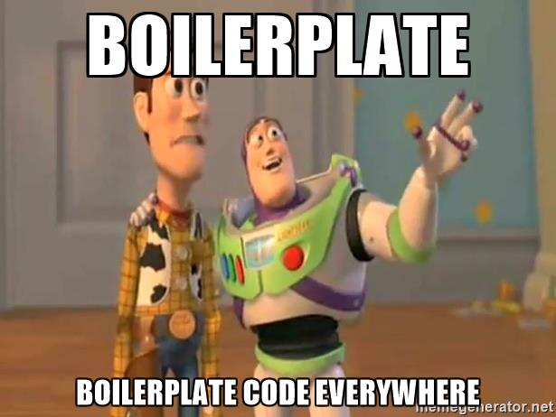
Stream
Notes:
In my opinion Java 8 code is better because of following reasons:
Java 8 code clearly reflects developer intent of filtering, sorting, etc.
Developers express what they want to do rather than how they want do it by using a higher level abstraction in the form of the Stream API.
The Stream API provides a unified language for data processing. Now developers will have a common vocabulary when talking about data processing. When two developers talk about a filter function, you can be sure that they both are applying a data filtering operation.
No boilerplate code is required to express data processing. Developers no longer have to write explicit for loops, or create temporary collections to store data. All is taken care by the Stream API itself.
Streams do not modify your underlying collection - they are non-mutating.

Slide 19
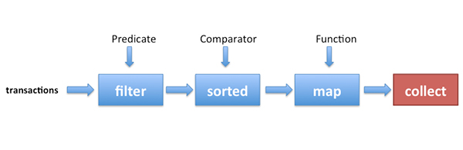
Stream
List<Integer> transactionsIds = transactions.parallelStream() .filter(t -> t.getType() == TransactionType.GROCERY) .sorted(comparing(Transaction::getValue).reversed()) .map(Transaction::getId) .collect(toList());

Slide 20
Stream
Source
Sequence of elements, arrays, collection, list, set
Flow
Intermediate operation
Aggregate operation
Pipelining
Internal iteration
Lazy evaluation
Sink
Final operation
Make the computation happen
Boss

Slide 21
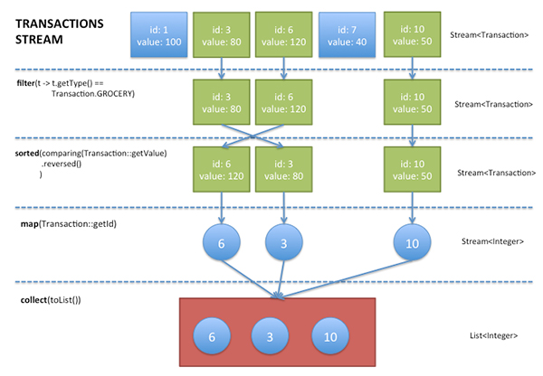
Stream
Notes:
a sequence of elements from a source that supports aggregate operations.” Streams consume from a source such as collections, arrays, or I/O resources. Streams support the common operations from functional programing languages, such as map, filter, reduce, find, sorted, etc

Slide 22
Stream
Notes:
a sequence of elements from a source that supports aggregate operations.” Streams consume from a source such as collections, arrays, or I/O resources. Streams support the common operations from functional programing languages, such as map, filter, reduce, find, sorted, etc

Slide 23
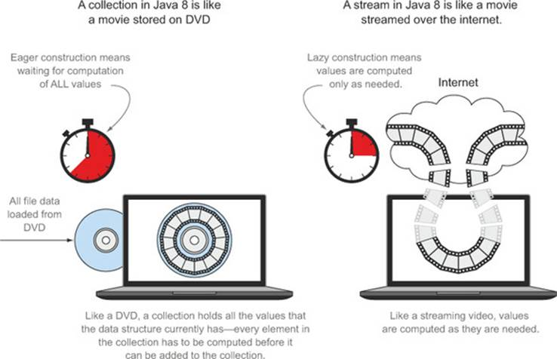
Stream vs Collection

Slide 24
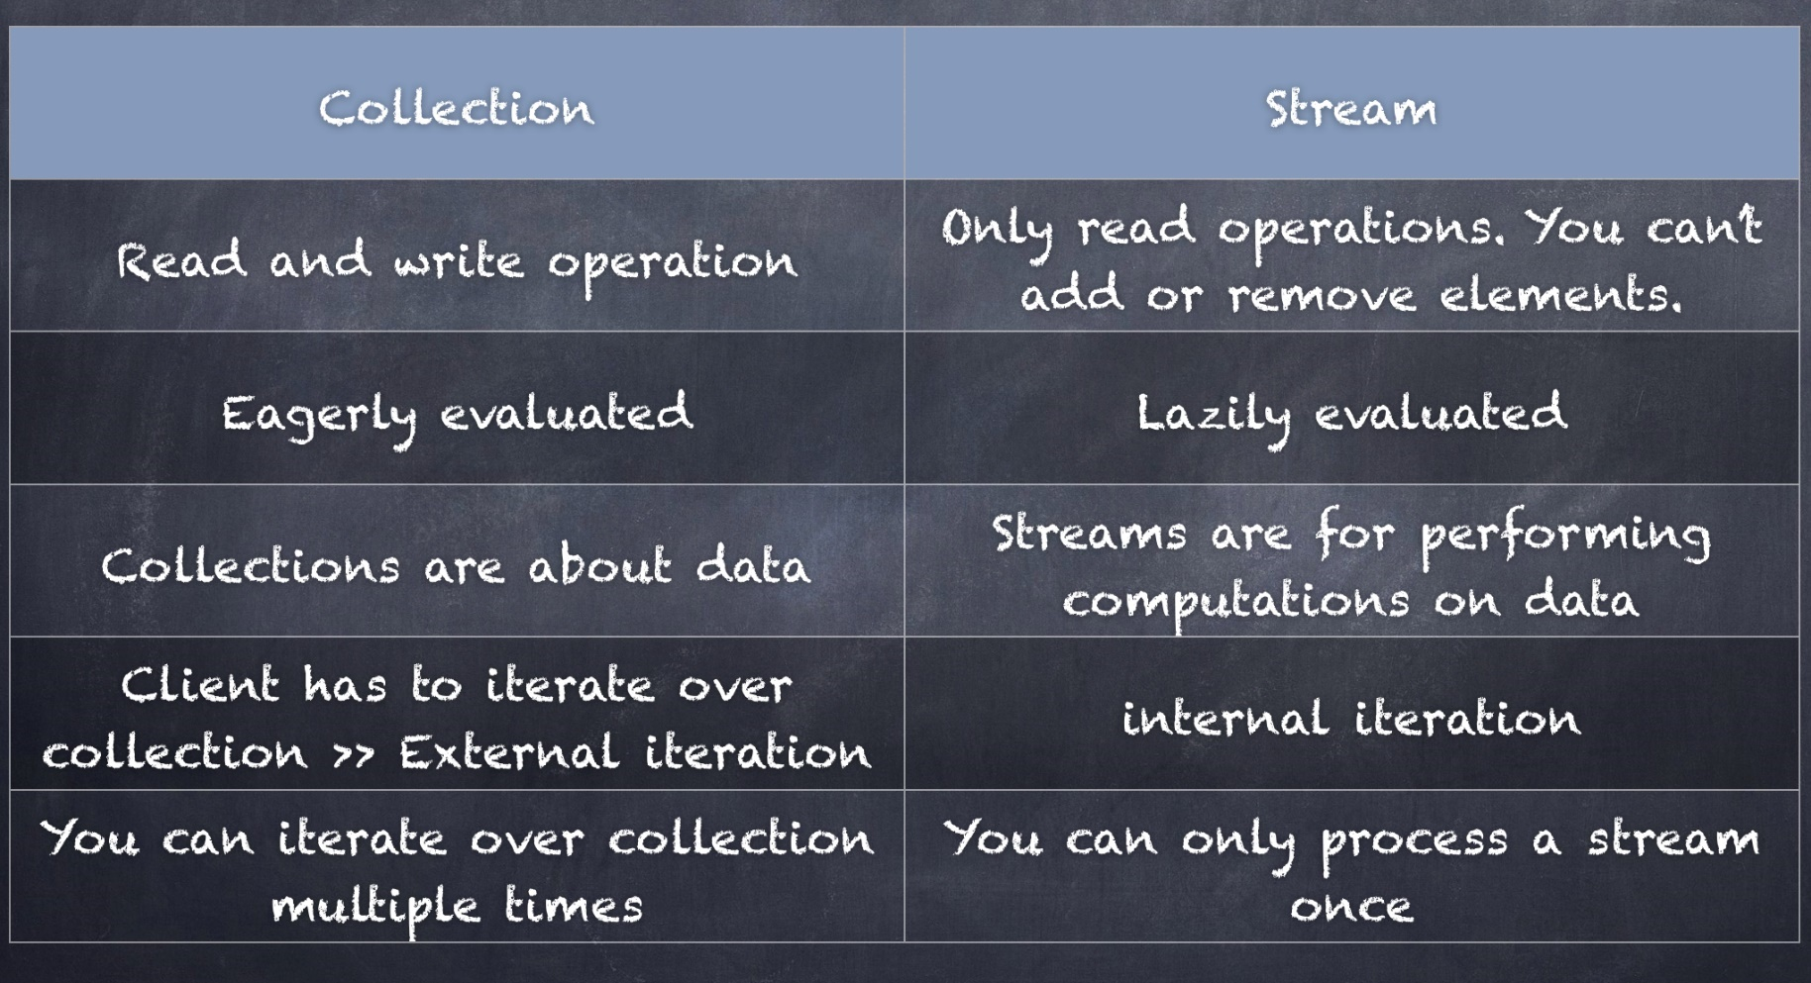
Stream vs Collection

Slide 25

Stream
New Date API

Slide 26
Parallel Programming
Pure Thread Management before Java 5
Thread
Runnable
Synchronized
volatile
Taking advantage of java.util.currency package from Java 5
Executor
ExecutorService
Future
ReentrantLock
Fork/Join framework from Java 7

Slide 27
Parallel Stream
List<Integer> numbers = Arrays.asList(0,4,5,6,2,3,1,8,7,9,56,17,29); // natural sorting numbers.stream() .sorted() .forEach(System.out::println); // natural sorting in parallel numbers.parallelStream() .sorted() .forEach(System.out::println);
Notes:
Then 2 code examples will be followed

Slide 28
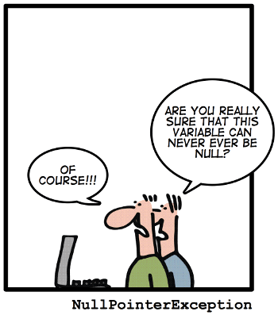
NPE? Annoying

Slide 29
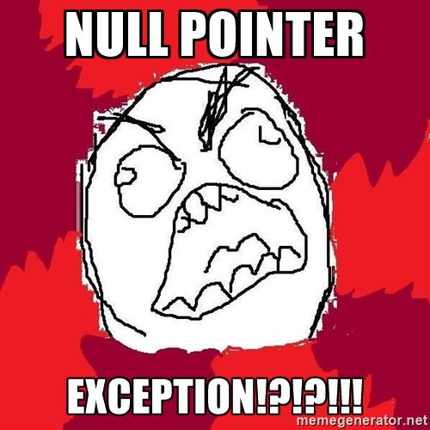
NPE? Annoying

Slide 30

NPE? Annoying

Slide 31
Optional<T>
A container which may or may not contain a non-null value
Common methods
isPresent() – returns true if value is present
Get() – returns value if present
orElse(T other) – returns value if present, or other
ifPresent(Consumer) – runs the lambda if value is present

Slide 32
Optional<T> with Value in it
// Create an instance of Optional Object
Optional<String> optionalGoal = Optional.of("goal");
// Check if there is a value in it System.out.println(optionalGoal.isPresent());
// Get the value
System.out.println(optionalGoal.get());
// If it contains no value, return fallback
System.out.println(optionalGoal.orElse("fallback"));
// Get executed only if there is value in it
optionalGoal.ifPresent((s) -> System.out.println(s.charAt(0)));

Slide 33
Optional<T> with Null
// Create an instance with NULL
Optional<String> optionalNull = Optional.ofNullable(null);
// Returns false since there is no value System.out.println(optionalNull.isPresent());
// Prints fallback since there is no value System.out.println(optionalNull.orElse("fallback"));
// no output, no NPE optionalNull.ifPresent((s) -> System.out.println(s.charAt(0)));

Slide 34
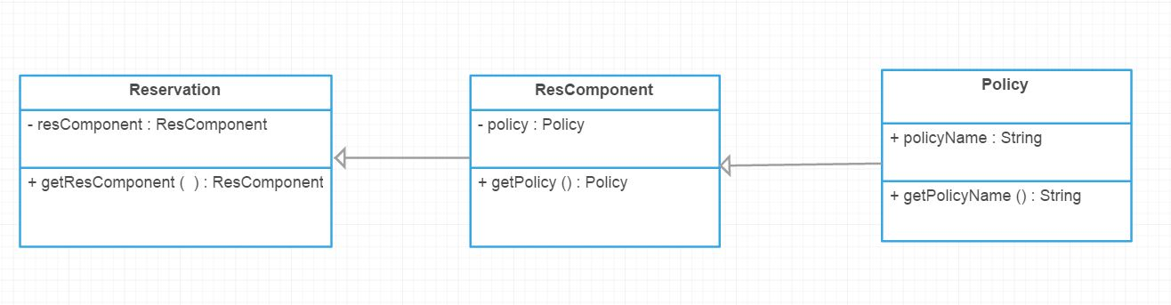
Optional<T> in TDP
Simplified TDP Reservation

Slide 35
Optional<T> in TDP
Get the Policy Name of a Reservation ? Before Java 8
if(reservation != null && reservation.getResComponent() != null && reservation.getResComponent().getPolicy() != null) {
System.out.println(reservation.getResComponent()
.getPolicy()
.getPolicyName());
}

Slide 36
Optional<T> in TDP
Get the Policy Name of a Reservation ? In Java 8
Optional.of(reservation) .map(Reservation::getResComponent) .map(ResComponent::getPolicy) .map(Policy::getPolicyName) .ifPresent(System.out::println);

Slide 37
Optional<T> Benifits
Null checks are not required.
No more NPE at run-time.
We can develop clean and neat APIs.
No more Boiler plate code.
Better readability.
Better maintainability.

Slide 38
Real Scenario in TDP
public static ResComponent getPrimaryResComponent(ResComponentGroup resCompGroup, Reservation res) { if (resCompGroup.getGroupMemberCount() > 0) { for (GroupMember groupMember : resCompGroup.getGroupMember()) { if (groupMember.hasPrimaryComponent() && groupMember.hasResComponentSequence()) { ResComponent resComp = ResComponentUtil.getResComponent(res,
groupMember.getResComponentSequence()); if (resComp != null) { return resComp; } } } } return null; }

Slide 39
Real Scenario in TDP
Improved by using λ, Stream and Optional
public static ResComponent getPrimaryResComponent(ResComponentGroup resCompGroup, Reservation res) { return Arrays.stream(resCompGroup.getGroupMember()) .filter(gm -> gm.hasPrimaryComponent() && gm.hasResComponentSequence()) .map(gm -> ResComponentUtil.getResComponent(res, gm.getResComponentSequence())) .findFirst() .orElse(null); }

Slide 40
New Date API

Slide 41

More Enjoyable!

Slide 42


